Slide 1
Improved Regularization of CNN with Cutout & Random Earsing
Team- Encoders
Padigala Lakshman Sai - 2021201069
D Prasanth Rao - 2021201005
B Anjaneyulu - 2021202008

Slide 2
Project objective
Understand the Importance of Regularization and To compare the different types on Data Augmentation like Cutout of image and Random Earsing

Slide 3
Introduction
CNN’s are capable of learning complex hierarchical feature representations of images. As the complexity of the task to be solved increases, the resource utilization of such models increases as well.
In order to combat the potential for overfitting, several different regularization techniques can be applied, such as data augmentation or the judicious addition of noise to activations, parameters, or data.
In this work, we perform the analysis between data augmentation techniques (CutOut & Random Erasing) with the baseline model.

Slide 4
Regularization
What is Regularization?
Regularization is a method to constraint the model to fit our data accurately and not overfit.
Why it occurs?
When the training data is relatively small and is an insufficient representation of the underlying distribution that it is sampled from, the model fails to learn a generalizable mapping.

Slide 5
Types of Regularization
Dropout
Data Augmentation
Rotating the image, flipping, scaling, shifting, cropping, etc.
Early Stopping
L1 & L2 Regularization

Slide 6
Data Augmentation
Cutout
In this work we consider applying noise in a similar fashion to dropout, but with two important distinctions.
The first difference is that units are dropped out only at the input layer of a CNN, rather than in the intermediate feature layers.
The second difference is that we drop out contiguous sections of inputs rather than individual pixels.
This simple method works in conjunction with other current state-of-the-art techniques such as residual networks, wide residual networks.

Slide 7
Data Augmentation
Random Erasing
It is similar to cutout but the amount of the patch to be cutout is randomly chosen with 50% probability.
The area of the patch varies between 2% to 40% of the total area of the image.
Different ways using in Random Erasing are:
Random Erase with Mean.
Random Erase with random pixel colors.

Slide 8
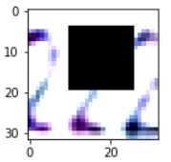
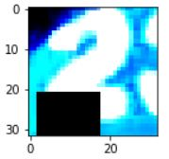
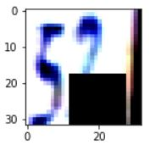
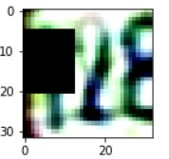
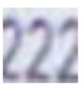

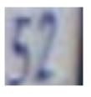

Images
Cutout Images
Original Images

Slide 9
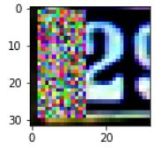
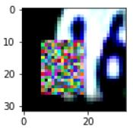
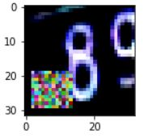
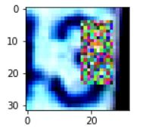
Images
Randomized Images (with Random value)

Slide 10
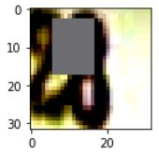
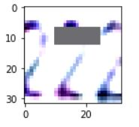
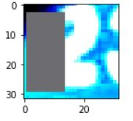
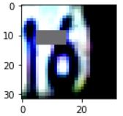
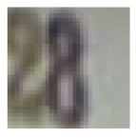
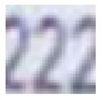
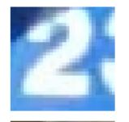
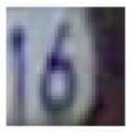
Images
Randomized Images
Original Images

Slide 11
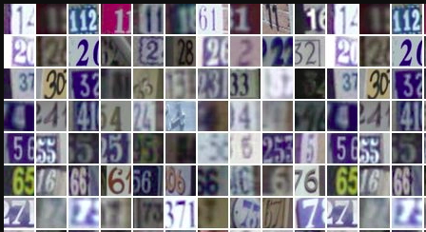
Data Set
SVHN
Images of Street View House Numbers, which is a real world dataset a benchmark dataset for digit classification.

Slide 12
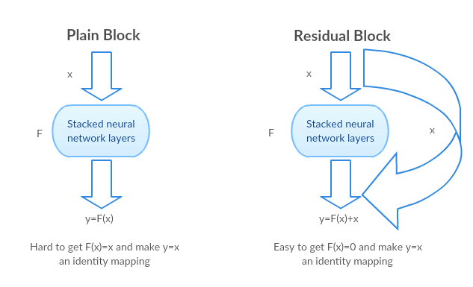
Implementation Details
ResNet-18
ResNet-18 is a convolutional neural network that is 18 layers deep with 3 skip connections and 4 Residual blocks

Slide 13
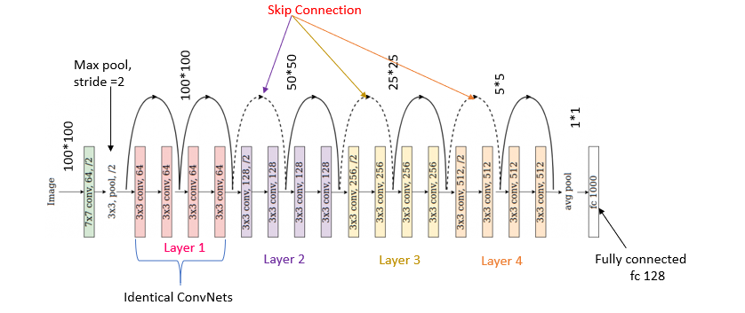
ResNet-18

Slide 14
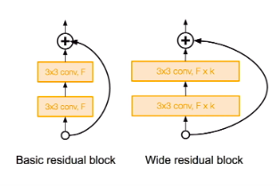
Implementation Details
WideResNet 16-8
widening Residual Network (ResNet), the network can be shallower with the same accuracy or improved accuracy. Shallower network means, Number of layers can be reduced, Training time can be shorter as well.
WideResNet with depth of 16 and widening factor of 8.

Slide 15
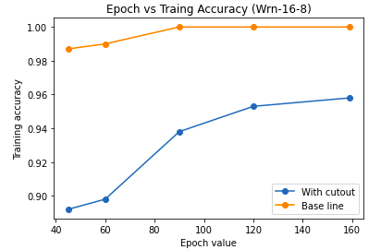
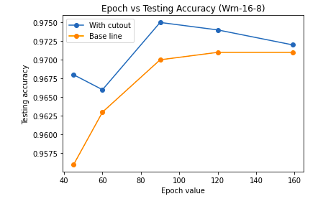
Results
Cutout with patch length of 20x20 using WideResNet-16-8
Regularization | Patch Size | Training Accuracy | Testing Accuracy
Cutout | 20X20 | 95.8 | 97.2
Without Cutout | - | 99.0 | 97.0

Slide 16
Results
Cutout with patch length of varying lengths using ResNet-18
Regularization | Patch Size | Training Accuracy | Testing Accuracy
Cutout | 8x8 | 95.3 | 92.2
Cutout | 12x12 | 93.6 | 94.1
Cutout | 16x16 | 90.4 | 94.8
Cutout | 20x20 | 85.7 | 95.3
Without Cutout | - | 96.6 | 89.3

Slide 17
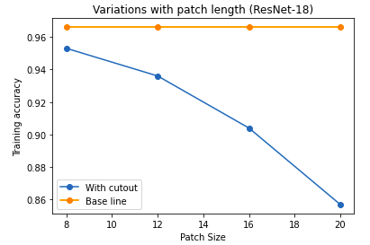
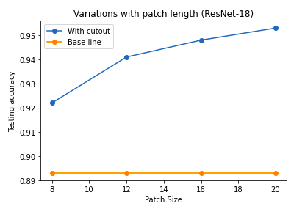
Cutout with different patch sizes
With the increase in patch size, we can see Increase in Testing Accuracy that is happening by avoiding overfitting as training accuracy is decreased.

Slide 18
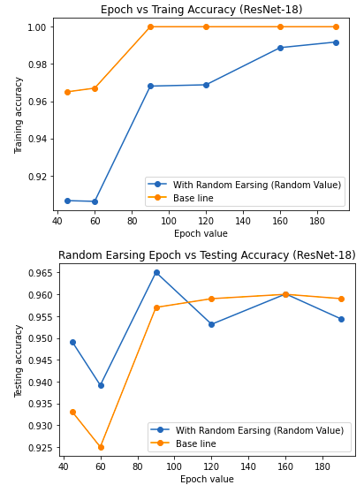
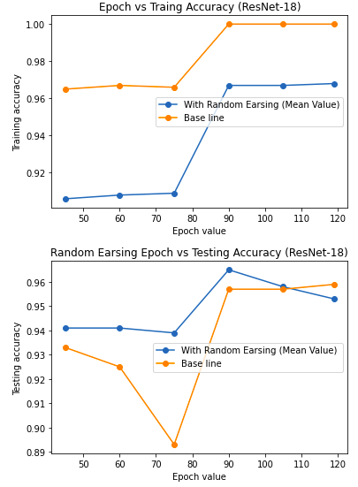
Random Earsing
Filling with Random Values
Filling with Mean Values

Slide 19
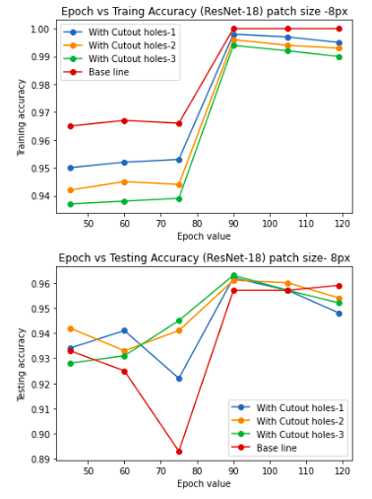
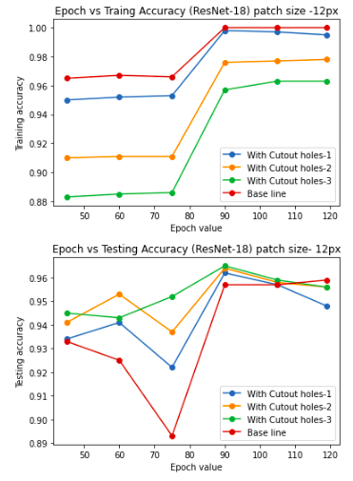
Some Other Experiments With Change in Number of Patches in Cutout

Slide 20
Conclusion
Thank You!
Data Augmentation techniques like Cutout and Random erasing are simple to implement and we can see that it has shown improvement in performance. In future we can use these techniques in object-detection, person identification and various recognition tasks.

